Slide 1

Machine Learning Project
Sai Supriya vengala

Slide 2
Objective
The data set (wine quality consists of 6497 obs. of 13 variables.
Objective method used- K mean clustering.
What information is revealed by clustering?
How should the value for the number of clusters be chosen?
Select the best segmentation and describe the clusters. How would your segmentation help understand wine quality analysis?

Slide 3
Objective method
The object method used for the dataset is K mean clustering as the dataset is large K means is usually used and relatively simple to use.
Method used: elbow
This method is used for separation distance from each cluster.
This measure has a range of (-1,1)
Elbow mwthod for optimal clusters
+1 indicates that the sample is far from neighboring cluster.
0 indicates sample is on very close to decision boundary, and -1 indicates sample is assigned to wrong cluster.

Slide 4
Information after clustering
Removing all categorical variable and using K means silhouette method the optimal no of clusters are k=5 where the data point is near to +1.
In this the elbow method analysis is used to choose an optimal value for n_clusters. Where we have found the optimal number of clusters formed are 5.
cluster 2,3 are below 0 which are near to the decision boundary
Other clusters 1,,4,5 are away from the neighboring clusters.

Slide 5
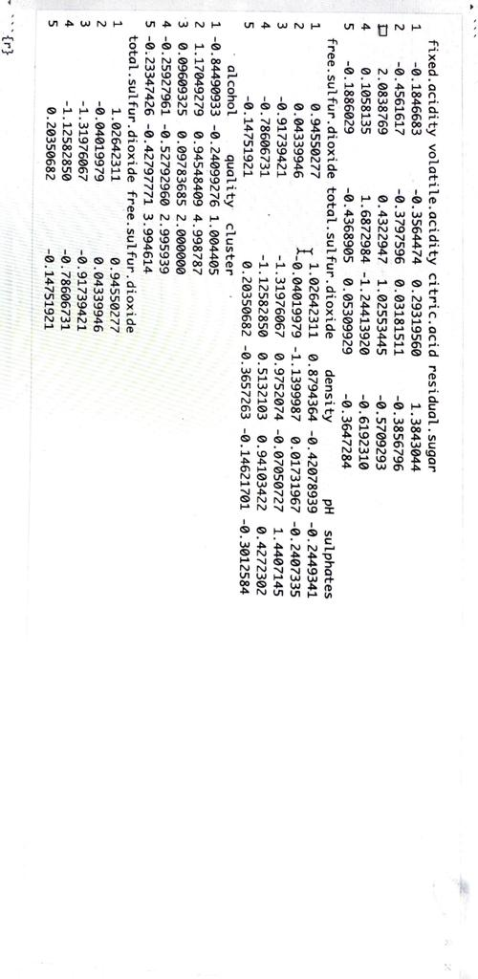
Ph and alcohol;in cluster 2 and 3 is more and cluster 1 and 4 is less per unit
And the sulfur dioxide per unit in cluster below <0
And sulphates more in 3 and 5
2 with high observations

Slide 6
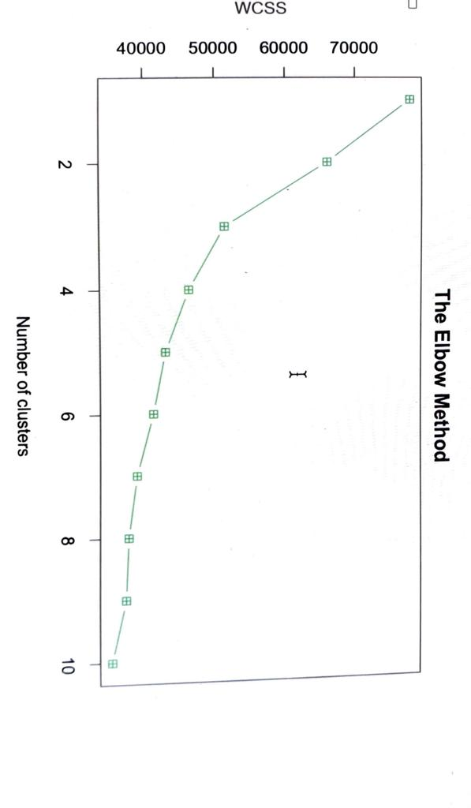
Elbow method for optimal clusters
K = 5 determined

Slide 7
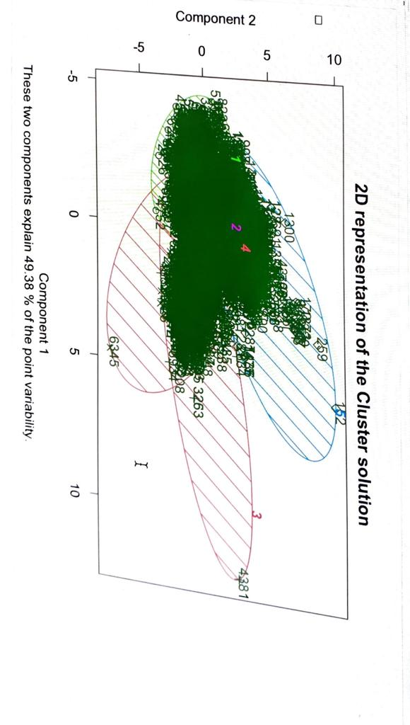
Clusters formed
Cluster-2 and 4 have more number per observations per unit compared to other all clusters
Cluster-3 have less heat per unit

Slide 8
Conclusion
K means elbow method the optimal no of clusters are k=5
Conclusion: Overall, the k means clustering analysis showed that there are cluster2 and 3 within the winequality dataset, with the primary differences being alcohol content and pH levels. These findings could potentially be used to inform the production and marketing of different types of wine.
Ph and alcohol in cluster 2 and 3 is more and cluster 1 and 4 is less per unit
Sulphates content is more in cluster 1 and 3 and less 5 and 4

